Slide 1
Research Project
Smart Car Parking System

Slide 2

Why Smart Car Parking System?
To reduce manual work
To increase the efficiency of parking system
To relieve traffic congestion
To provide security
To reduces CO2 emissions

Slide 3
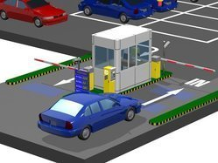
Process of Smart Car Parking System?

Slide 4
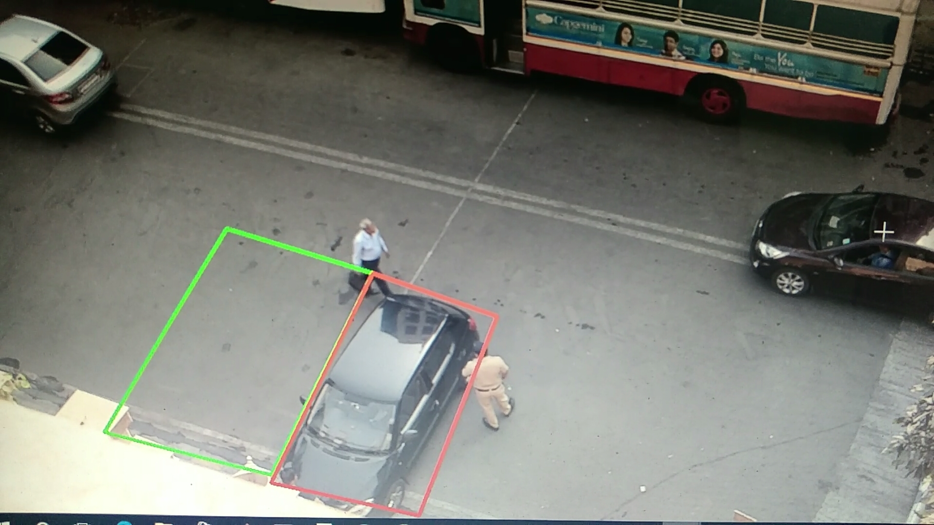
How to implement Smart Car Parking System?

Slide 5
Thank You!

